Slide 1
DEADLOCKS Resources Introduction To Deadlocks The Ostrich Algorithm Deadlock Detection & Recovery

Slide 2
Review
Memory-Mapped I/O
Map all the control registers into the memory space
Each control register is assigned a particular and unique memory address
DMA
A memory address register
A byte count register
One or more control registers
3 modes: Word-at-a-time, Block, Fly-by
Precise vs. Imprecise Interrupt
Precise: Leave the machine in a well-defined state
PC is saved in a known place
All instructions before the one pointed to by the PC have fully executed
No instruction beyond the one pointed to by the PC has been executed
Execution state of the instruction pointed to by the PC is known
Imprecise: Does not meet all requirements as precise

Slide 3
Review
I/O Software
Goals
Device Independent, Error handling, Synchronous vs. Asynchronous, Buffering, Dedicated device allocation
I/O with DMA
Layers
User level I/O software: pooling with daemon scheduling (Asynchronous)
Device independent
Uniform naming, Uniform interface, Independent block size
Buffering
Error handling, Dedicated device allocation
Device Drivers: help OS control specified devices depending on standard interface
Interrupt Handlers: handle interrupt to determine what the system should do

Slide 4
Review
Disk arm scheduling
Seek time
FCFS: Process request sequentially
SSF: the least movement of the disk arm from its current head position
Elevator
Approach: Arm moves in one direction only, satisfying all outstanding requests until it reaches the last track in that direction
Implementation: When the highest numbered cylinder with a pending request has been services, the arm goes to lowest number cylinder with a pending request and then continues moving in an upward direction
Rotational delay
If two or more requests for the same cylinder are pending, the driver can issue a request for the sector that will pass under the head next
The OS should maintain a pending request table for each drive, a seek should be issued to move its arm to the cylinder where it will be needed next
Actual data transfer time (SATA)

Slide 5
Review
Disk arm scheduling
Error handling
Bad sector
Sectors do not correctly read back the value just written to them
Controllers remap the bad sector to the spare and/or Shift all the sectors up one
OS must first acquire a list of bad sectors, then it can build remapping tables
Seek errors
Move the arm as far out as it will go and reset the controller’s internal idea of the current cylinder to 0

Slide 6
Review
Disk arm scheduling
Disk Consistency
Stable write: Write block on drive 1, then reading it back to verify. The driver 2 is written and reread until it succeeds
Stable read: First read block on drive 1 in n times. If all of these give bad ECCs, reading on drive 2
Crash recovery: scans both disks comparing corresponding blocks. Bad block is overwritten with the good blocks or block from driver 1 is written onto drive 2
Optimizing: using Nonvolatile/ Volatile RAM to replace in using driver 2
Thin Client
Power Manager
The programs to use less energy, even if this means providing a poorer user experience
Display, HDD, CPU, Memory, Wireless, Driver Interface

Slide 7
Review
Clocks
02 types
Using volt power
a crystal oscillator, a counter, and a holding register
2 modes: one shot mode, square wave mode
Functions
Maintaining the time of day (real time).
Preventing processes monopolizing CPU
Accounting for CPU usage
Handling alarm system call
Providing watchdog timers
Doing profiling, monitoring, statistics gathering
User Interfaces
Input software (Keyboard software: scan code, echoing, tab handling, device equivalent
Output software (Text window, X Window, GUI, Bitmaps, Fonts)
Mouse software

Slide 8
Objectives
Resources
Preemptable and Nonpreemptable Resources
Resource Acquisition
Introduction To Deadlocks
Conditions for Resource Deadlocks
Deadlock Modeling
The Ostrich Algorithm
Deadlock Detection & Recovery
Deadlock Detection with One Resource of Each Type
Deadlock Detection with Multiple Resources of Each Type
Recovery from Deadlock

Slide 9
Overviews
Context
Computer systems are full of resources that can only be used by one process at a time
All OS have the ability to (temporarily) grant a process exclusive access to certain resources
A process needs exclusive access do not one resource, but several
A set of blocked processes each holding a resource and waiting to acquire a resource held by another process in the set, thus they will remain so forever (deadlocks).
Deadlock does not occur only on local machine but also across machines
Deadlocks can occur in a variety of different situations such as requesting dedicated I/O devices, on hardware or software resources

Slide 10
Resources
Refer the objects as hardware devices, data records, files, etc .. that must be granted, acquired, used and released
A computer will normally have many different resources
Some resource is the identical instances may be available
Some resource is copied of a resource available
There are two type resources
Preemptable
Nonpreemptable

Slide 11
Resources
Preemptable
Is resources that can be taken away from the process owning it with no ill effects (either on system or others)
Preemptable resources can be resolved deadlocks by reallocating resources from one process to another
Ex:
A system with 256 MB of user memory, one printer, and two of 256 MB processes that each want to print some thing
Process A requests and gets the printer, then starts to compute the values to print. Before it has finished with the computation, it exceeds its time quantum and is swapped out (Process A has the printer, but it locates on disk)
Process B now runs and tries, unsuccessfully to acquire the printer (Process B locates on memory, but it cannot access the printer)
→ Process A take away the B’s memory by swapping process B out & swapping process A in. After finished, process A releases both

Slide 12
Resources
Nonpreemptable
Is resources that cannot taken away from its current owner without causing the computation to fail
Ex
If the process has begun to burn a CD-ROM, suddenly taking the CD recorder away from it and giving it to another process will result in a garbled CD
Deadlocks involve nonpreemptable resources

Slide 13
Resources
Resource Acquisition
The sequence of events required to use resource
Request the resource
Use the resource
Release the resource
One of way allowing user manager of resources is to associate a semaphore with each resource
The semaphores are all initialized to 1
A down to acquire the resource, using the resource
A up on the resource to release resource

Slide 14
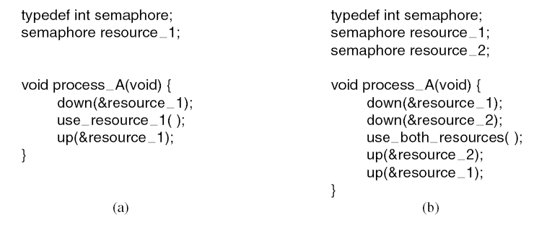
Resources
Resource Acquisition
Tanenbaum, Fig. 6-1.

Slide 15
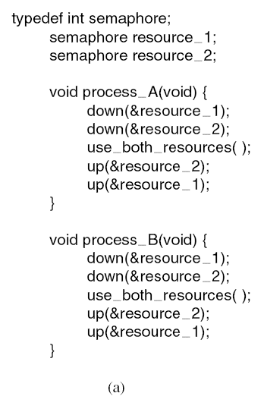
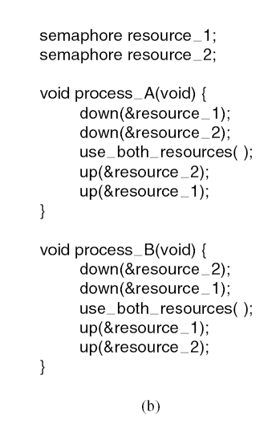
Resources
Resource Acquisition
Deadlock
Tanenbaum, Fig. 6-2.

Slide 16

Introduction to Deadlocks
A set of processes is deadlocked if each process in the set is waiting for an event that only another process in the set can cause
None of processes can run
None of them can release any resources
None of them can be awakened
→ All the processes continue to wait forever
Assume
Processes have only a single thread and
There are no interrupts possible to wake up a blocked processes

Slide 17
Introduction to Deadlocks
Conditionals for Resource Deadlocks
Resource Deadlocks
A resource that is owned by a deadlocked process
Four conditions must hold for there to be a deadlock
Mutual exclusion condition
Each resource is either currently assigned to exactly one process or is available
Hold and wait condition.
A process currently holding at least one resource is waiting to acquire additional resources held by other processes
No preemption condition.
A resource can be released only voluntarily by the process holding it, after that process has completed its task
Circular wait condition
There must be a circular chain of two or more process, each of which is waiting for a resource held by the next member of chain

Slide 18




Introduction to Deadlocks Deadlock Modeling
Four conditions for resource deadlocks can be modeled using directed graphs (Holt – 1972)
The graphs have two kinds of nodes
Processes that are shown as circles
Resources that are shown as squares
A directed arc from a resource to process
The process is holding an instance of resource
A directed arc from a process to resource
The process is currently blocked and requests instance of resource
Tanenbaum, Fig. 6-3.

Slide 19
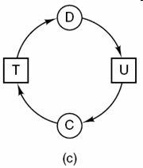
Introduction to Deadlocks
Deadlock Modeling – Examples
Tanenbaum, Fig. 6-3

Slide 20
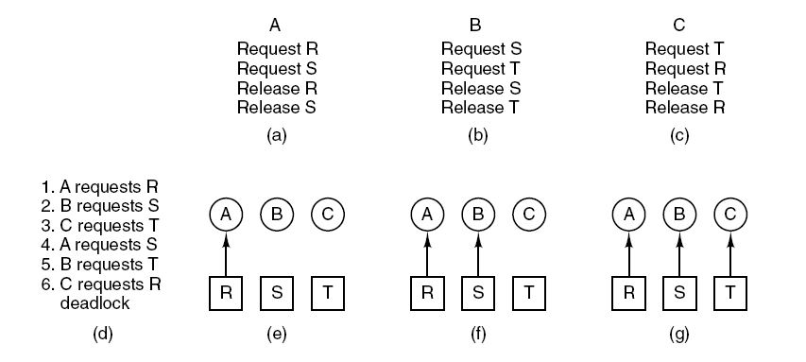
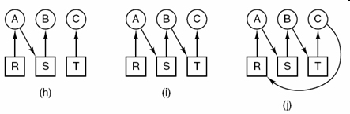
Introduction to Deadlocks Deadlock Modeling – Examples
Tanenbaum, Fig. 6-4.

Slide 21
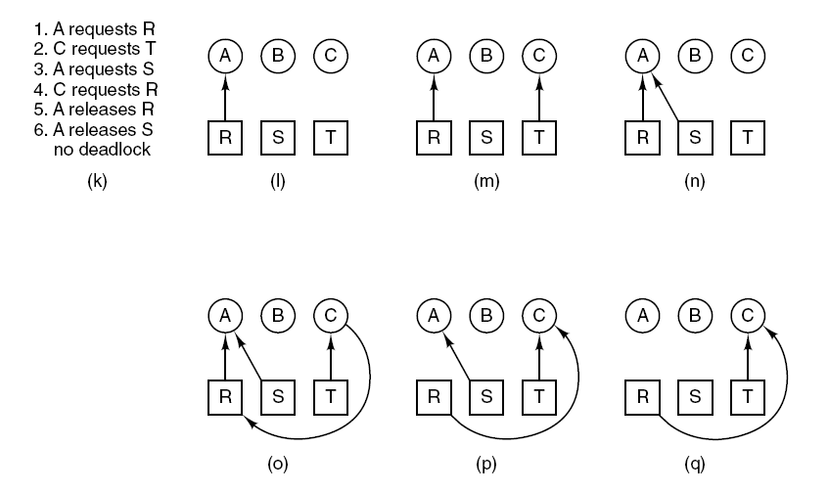
Introduction to Deadlocks Deadlock Modeling – Examples
Tanenbaum, Fig. 6-4

Slide 22
Introduction to Deadlocks
Deadlock Modeling
Resource graphs are a tool that
Let see of a given request/ release request sequence leads to deadlock
Help carrying out the requests and releases step by step, and after every step check the graph to see if it contains any cycles to check deadlock or not
Can generalized to handle either single resource or multiple resource
Basic facts
If graph contains no cycles → no deadlock
If graph contains a cycle
If only one instance per resource type, then deadlock
If several instances per resource type, possibility of deadlock

Slide 23
Introduction to Deadlocks Deadlock Modeling
Strategies for dealing with deadlocks
Just ignore the problem
Maybe if you ignore it, it will ignore you
Detection and recovery.
Let deadlocks occur, detect them, take action.
Dynamic avoidance by careful resource allocation.
Prevention, by structurally negating one of the four required conditions

Slide 24
The Ostrich Algorithms
Just ignore the problem
Stick your head in the sand and pretend is no problem at all
Different people react in different ways
Mathematicians
Totally unacceptable and must prevent deadlocks at all costs
Engineers
Would not be willing pay a large penalty in performance or convenience to eliminate deadlocks
OS blocks caller that requests the busy device
The device driver decide blocking or returning an error code

Slide 25
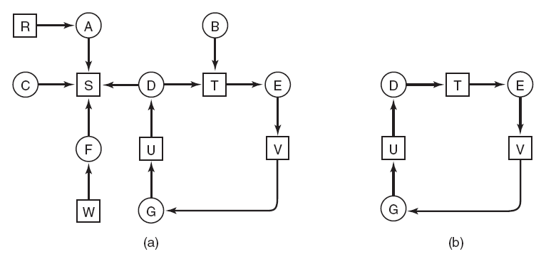
Deadlock Detection & Recovery Deadlock Detection with One Resource of Each Type
Tanenbaum, Fig. 6-5.

Slide 26
Deadlock Detection & Recovery Deadlock Detection with One Resource of Each Type
Algorithm for detecting deadlock:
For each node, N in the graph, perform the following five steps with N as the starting node.
Initialize L to the empty list, designate all arcs as unmarked.
Add current node to end of L, check to see if node now appears in L two times. If it does, graph contains a cycle (listed in L), algorithm terminates.
From given node, see if any unmarked outgoing arcs. If so, go to step 5; if not, go to step 6.
Pick an unmarked outgoing arc at random and mark it. Then follow it to the new current node and go to step 3.
If this is initial node, graph does not contain any cycles, algorithm terminates. Otherwise, dead end. Remove it, go back to previous node, make that one current node, go to step 3

Slide 27
Deadlock Detection & Recovery Deadlock Detection with Multiple Resource of Each Type
A matrix-based algorithm among n processes, P₁ through P_{n} and m resource classes, E₁ through E_{m}
Let E be the existing resource vector that gives the total number of instance of each resource in existence
Let A be the available resource vector, with A_{i} giving the number of instances of resource i that are current available/ unsigned
Let C be the current allocation matrix, with
The i-th row of C tells how many instances of each resource class P_{i} currently holds
C_{ij} is the number of instances of resource j that P_{i} holds
Let R be the request matrix, with
The i-th row of P tells how many instances of each resource class P_{i} currently wants
R_{ij} is the number of instances of resource j that P_{i} wants

Slide 28
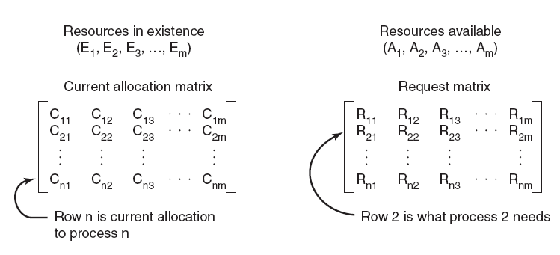
Deadlock Detection & Recovery Deadlock Detection with Multiple Resource of Each Type
Tanenbaum, Fig. 5-46.

Slide 29
Deadlock Detection & Recovery Deadlock Detection with Multiple Resource of Each Type
Each process is initially said to be unmarked
Deadlock detection algorithm
Look for an unmarked process, P_{i}, for which the R_{i} is less than or equal to A.
If such a process is found, add C_{i} to A, mark the process, and go back to step 1.
If no such process exists, the algorithm terminates
As the algorithm progresses, processes will be marked, indicating that they are able to complete and are thus not deadlocked
When the algorithm terminates, any unmarked processes are known to be deadlocked
This algorithm assumes a worst-case scenario: all processes keep all acquired resources until they exit

Slide 30
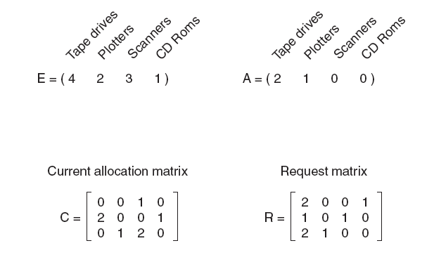
Deadlock Detection & Recovery Deadlock Detection with Multiple Resource of Each Type
No Process deadlock
Progress: 3, 2, 1
Process 1, 2 deadlock
Progress: 3
2 1 0 1
Tanenbaum, Fig. 6-7.

Slide 31
Deadlock Detection & Recovery Deadlock Detection with Multiple Resource of Each Type
No Process deadlock

Slide 32
Deadlock Detection & Recovery Deadlock Detection with Multiple Resource of Each Type
Process 2, 3, 4, 5 deadlock

Slide 33
Deadlock Detection & Recovery Recovery from Deadlock
Recovery through Preemption
The ability to take a resource away from a process, have another process use it, and then give it back without the process noticing it is highly dependent on the nature of the resource
It may be possible to temporarily take a resource away from its current owner and give it to another process
Choosing the process to suspends largely on which ones have resources that can easily be taken back
In many cases, manual intervention may be required, especially in batch processing OS running on mainframes
→Is frequently difficult or impossible

Slide 34
Deadlock Detection & Recovery Recovery through Rollback
Checkpoint
Is supported the system designers and machine operators know that deadlocks are likely
Contains not only the memory image, but also the resource state assigning currently to the process
→ Checkpointing a process
Process’s state is written to a file so that it can be restarted later
To be most effective, new checkpoints should not overwrite old ones but should be written to new files, so as the process execute, a whole sequence accumulates
Recovery
When a deadlock is detected, a process is reset to an earlier checkpoint that did not have the resource
Then, the resource is assigned to one of the deadlock processes
If the restarted process tries to acquire the resource again, it will have to wait until resource becomes available

Slide 35
Deadlock Detection & Recovery Recovery through Killing Processes
Kill one or more process(es) in the cycle (it’s crudest but simplest)
First approach
Repeating until the cycle is broken
Kill process in the cycle
Check the cycle, if so, go back to the first line
Second approach
A process not in a cycle can be chosen as the victim in order to release its resource
The process to be killed is carefully chosen because it is holding resources that some process in the cycle needs
Notes: The process victim should be chosen only if it can be rerun from the beginning with no ill effects

Slide 36
Summary
Resources
Introduction To Deadlocks
The Ostrich Algorithm
Deadlock Detection & Recovery
Q&A

Slide 37
Next Lecture
Deadlock Avoidance
Deadlock Prevention
Other Issues

Slide 38
DEADLOCKS Deadlock Avoidance Deadlock Prevention Other Issues

Slide 39
Review
Deadlock
A set of blocked processes each holding a resource and waiting to acquire a resource held by another process in the set, thus they will remain so forever (deadlocks)
Resources
Refer the objects as hardware devices, data records, files, etc .. that must be granted, acquired, used and released
02 types: Preemptable, Nonpreemptable
4 conditions
Mutual exclusion condition
Hold and wait condition
No preemption condition
Circular wait condition
Four conditions for resource deadlocks can be modeled using directed graphs that help carrying out the requests and releases step by step, and after every step check the graph to see if it contains any cycles to check deadlock or not

Slide 40
Review
Deadlock
Strategies
The Ostrich Algorithms
Just ignore the problem
The device driver decide blocking or returning an error code
Detection
Deadlock Detection with One Resource of Each Type: using algorithm to traverse the directed graph using Deadlock modeling
Deadlock Detection with Multiple Resource of Each Type: using existing resource vector (E), available resource vector (A), current allocation matrix (C), request matrix (R)
Recovery
Recovery through Preemption: take a resource away from a process, have another process use it, and then give it back without the process noticing it is highly dependent on the nature of the resource
Recovery through Rollback: checkpoint is used to store the process state that is used to reset when the deadlock occurs
Recovery through Killing Processes: break the cycle with internal and external resources

Slide 41
Objectives …
Deadlock avoidance
Resource Trajectories
Safe and Unsafe States
The Banker’s Algorithms for a Single Resource
The Banker’s Algorithms for a Multiple Resource
Deadlock Prevention
Attacking the Mutual Exclusion Condition
Attacking the Hole and Wait Condition
Attacking the No Preemption Condition
Attacking the Circular Wait Condition
Other Issues
Two-Phase Locking
Communication Deadlocks
Live Lock
Starvation

Slide 42
Deadlock Avoidance Context
In most system, resources are requested one at a time (does not ask resources all at one)
The system must be able to decide whether granting a resource is safe or not and only make the allocation when it is safe
Is there an algorithm that can always avoid deadlock by making the right choice all the time?
Yes, the deadlock can be avoided, but only if certain information is available in advance
→carefully resource allocation

Slide 43
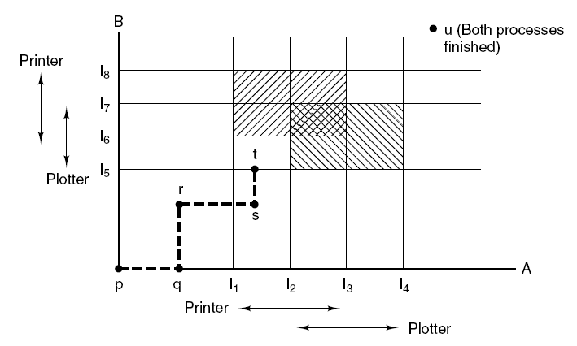
Deadlock Avoidance Resource Trajectories
Tanenbaum, Fig. 6-8.

Slide 44
Deadlock Avoidance Safe and Unsafe States
A state is said to be safe if there is some scheduling order in which every process can run to completion even if all of them suddenly request their maximum number of resources immediately
A system is in a safe state only if there exists a safe sequence
Let n process in order P₁ … P_{n}. Each process is a safe sequence for current allocation state if
For each P_{i}, the resources that P_{i} still request can be satisfied by the currently available resources plus the resources held by all the P_{j}, with j<i
If the resource that P_{i} needs are not immediately available, the P_{i} can wait until all P_{j} have finished
When P_{i} terminates, the P_{i+1} can obtain its needed resource
→ The system state is unsafe when the above condition does not exist

Slide 45
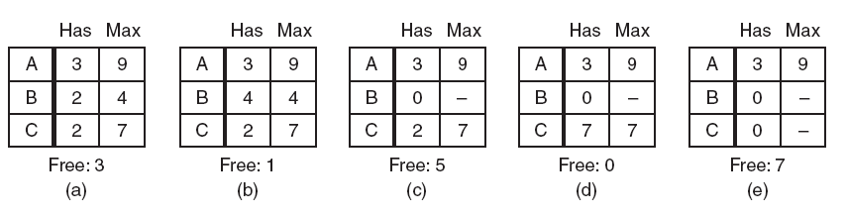
Deadlock Avoidance Safe and Unsafe States
Tanenbaum, Fig. 6-9.
Safe
3 processes
1 resource with
10 instance

Slide 46
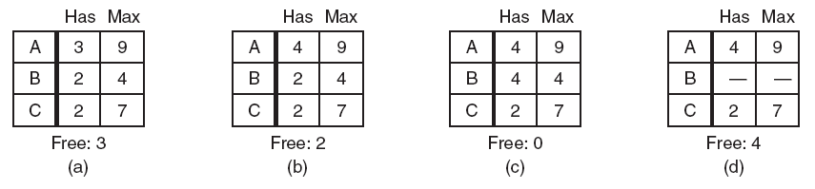
Deadlock Avoidance Safe and Unsafe States
UnSafe
3 processes
1 resource with
10 instance
Tanenbaum, Fig. 6-9.

Slide 47
Deadlock Avoidance Safe and Unsafe States
Basic fact
If a system is in safe state → no deadlocks
If a system is in unsafe state → possibility of deadlock
To avoidance deadlocks → ensure that a system will never enter an unsafe state

Slide 48
Deadlock Avoidance The Banker’s Algorithm for a Single Resource
Is used to avoid and detect deadlock
Ideas
A small-town banker might deal with a group of customers to whom he has granted lines of credit (to making loan requests time to time)
Algorithm
Considers each request as it occurs, and sees if granting it leads to a safe state
If it does, the request is granted; otherwise, it is postponed until later
To see if a state is safe, the banker checks to see if he has enough resources to satisfy some customer
If so, those loans are assumed to be repaid, and customer now closest to the limit is checked
If all loans can eventually be repaid, the state is safe and the initial request can be requested

Slide 49
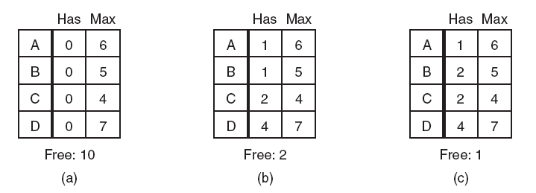
Deadlock Avoidance The Banker’s Algorithm for a Single Resource
Safe Safe Unsafe
Tanenbaum, Fig. 6-11.

Slide 50
Deadlock Avoidance The Banker’s Algorithm for a Multiple Resource
Algorithm for checking to see if a state is safe:
Look for row, R, whose unmet resource needs all ≤ A. If no such row exists, system will eventually deadlock since no process can run to completion
Assume process of row chosen requests all resources it needs and finishes.
Mark process as terminated, add all its resources to the A vector.
Repeat steps 1 and 2 until either all processes marked terminated (initial state was safe) or no process left whose resource needs can be met (there is a deadlock).
Disadvantages:
It is essentially useless because process rarely know in advance what their maximum resource needs will be
In addition, the number of processes is not fixed, but dynamically varying as new users log in and out
Furthermore, resources that were thought to be available can suddenly vanish

Slide 51
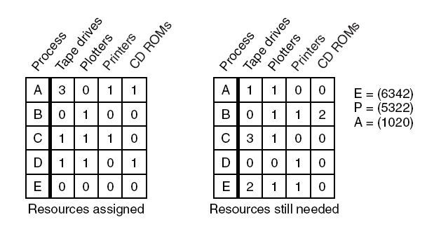
Deadlock Avoidance The Banker’s Algorithm for a Multiple Resource
Progress: D, E, A, B, C
Tanenbaum, Fig. 6-11.

Slide 52
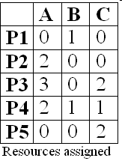
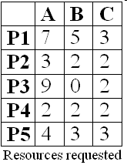

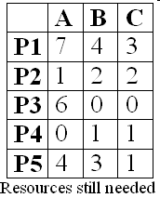
Deadlock Avoidance The Banker’s Algorithm for a Multiple Resource
No Process deadlock

Slide 53
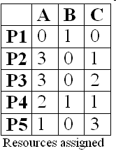

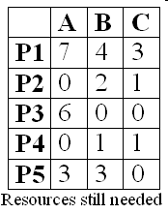
Deadlock Avoidance The Banker’s Algorithm for a Multiple Resource
All Process are deadlocked

Slide 54
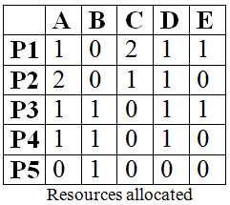

Deadlock Avoidance The Banker’s Algorithm for a Multiple Resource
 | A | B | C | D | E
P1 | 1 | 1 | 2 | 1 | 2
P2 | 2 | 2 | 2 | 1 | 0
P3 | 2 | 1 | 3 | 1 | 1
P4 | 1 | 1 | 1 | 2 | 1
P5 | 0 | 1 | 1 | 1 | 1
Maximum Resources requested
What is the smallest value of x for which this is a safe state? And which progress of processes?

Slide 55
Deadlock Avoidance The Banker’s Algorithm for a Multiple Resource
 | A | B | C | D | E
P1 | 0 | 1 | 0 | 0 | 1
P2 | 0 | 2 | 1 | 0 | 0
P3 | 1 | 0 | 3 | 0 | 0
P4 | 0 | 0 | 1 | 1 | 1
P5 | 0 | 0 | 1 | 1 | 1
Resources still needed
- The smallest value of x is 1
- The progress is P4, P5, P1, P2, P3

Slide 56
Deadlock Avoidance The Banker’s Algorithm for a Multiple Resource
A system has five processes and three allocated resources. The current allocation and request needs are as follows:
Process | Allocated | Currently Request | Available
A | 010 | 000 | 100
B | 200 | 202
C | 303 | 001
D | 211 | 100
E | 022 | 002
- What do the processes progress in sequence?
- The progress is A, D, C, E, B

Slide 57
Deadlock Prevention Attacking the Mutual Exclusion Condition
Avoiding assigning a resource when that is not absolutely necessary, and
Try to make sure that as few processes as possible may actually claim the resource
Ex
spooling and daemon in printer (user software layer)

Slide 58
Deadlock Prevention Attacking the Hold and Wait Condition
Must guarantee that whenever a process requests a resource, it does not hold any other resources, or
Prevent process that holds resource from waiting for more resources
→ all process to request all their resources before starting execution
If everything is available, the process will be allocated whatever it needs and can run to completion
If one ore more resources are busy, nothing will be allocated and the process would just wait
Problems
Many process do not know how many resources they will need until they have started running
Resources will not be used optimally
Disadvantages: put a burden on the programmer and waste resource
Advantages: prevent deadlocks and can be applied to batch system
Others: require a process requesting a resource to first temporarily release all the resource it currently holds, then it tries to get everything it needs all at one

Slide 59
Deadlock Prevention Attacking the No Preemption Condition
If a process that is holding some resources requests another resource that cannot be immediately allocated to it, then all resources currently being held are released
Preempted resources are added to the list of resources for which the process is waiting
Process will be restarted only when it can regain its old resources, as well as the new ones that it is requesting
Some recourse can be virtualized to avoid the first condition such as spooling and daemon

Slide 60
Deadlock Prevention Attacking the Circular Wait Condition
First approach
A process is entitled only to a single resource at the moment.
If it needs a second one, it must release the first one
→if a process needs to copy a huge file from a tape to a printer, this restriction is unacceptable
Second approach
Provide a global numbering of the resources
Process can request resources whenever they want to, but all requests must be made in numerical order
→ the resource allocation graph can never have cycles but the numerically ordering the resources may be impossible to find an ordering that satisfies every ones

Slide 61
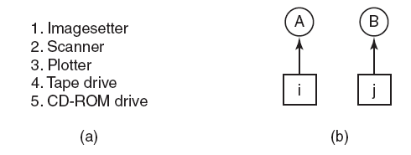
Deadlock Prevention Attacking the Circular Wait Condition
Tanenbaum, Fig. 6-13.
Deadlock occurs only if A request j and B request i (i ≠ j)
If i>j, the A is not allowed to request j because that is lower than what it already has
If i<j, the B is not allowed to request i because that is lower than what is already has
→ deadlock is impossible

Slide 62
Deadlock Prevention Attacking the Circular Wait Condition
With more than two processes
At every instant, one of the assigned resources will be highest
The process holding that resource will never ask for a resource already assigned
It will either finish, or at worst, request even higher numbered resources, all of which are available
Eventually, it will finish and free resources. At this point, some other process will hold the highest resource and can also finish
→all processes finish, so no deadlock occurs
A minor variation of the algorithm
Drop the requirement that resource be acquired in strictly increasing sequence and merely insist that no process request a resource lower than what it is already holding

Slide 63
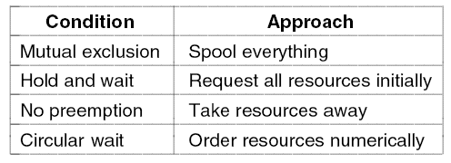
Deadlock Prevention Summarized
Tanenbaum, Fig. 6-14.

Slide 64
Other Issues Two-Phase Locking
Context
In many DB systems, an operation that occurs frequently is requesting locks on several records and then updating all the locked records
When multiple processes are running at the same time, there is a real danger of deadlock
Two-phase locking
First phase, the process tries to lock all records it needs, one at a time.
If it succeeds, it begins the second phase, performing its updates and releasing the locks (then starts the first phase all over)
→request all the resources needed in advance, or at least before irreversible is done
There is no release and restart of a locked record is encountered during the first phase → deadlock can occur
This strategy is not applicable in general for many applications (except DB systems)
To apply, the programmer has very carefully arranged things so that the program can be stopped at any point during the first phase and restart

Slide 65
Other Issues Communication Deadlocks
Deadlock can occur in communication system in which two or more process communicate by sending message
Problems
Process A sends a request message to process B, then blocks until B sends back reply the message
If the request message gets lost, both A and B are blocked
Communication deadlock
The set of processes is deadlock if each blocked waiting for an event only the other one can cause
Cannot be prevented by ordering the resource (since there are none) or avoided by careful scheduling (since there are no moments when a request could be postponed)
→deadlock is prevented using timeout (or handling alarm)

Slide 66
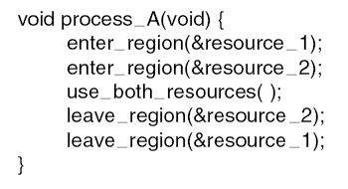
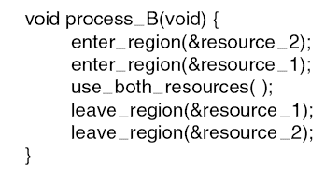
Other Issues LiveLock
Context
Mutual exclusion
Busy waiting
Definition
Each process acquires one resources, but it is not progressing because it uses up its CPU quantum over and over and over to checking to take/ enter the resource/ critical regions (in the other word, it is running)
→ Is the equivalent of deadlock but no process is blocked (and it is similar to starvations because the process must wait for a long time)
Tanenbaum, Fig. 6-16.

Slide 67
Other Issues LiveLock
Context
Mutual exclusion
Busy waiting
Definition
Each process acquires one resources, but it is not progressing because it uses up its CPU quantum over and over and over to checking to take/ enter the resource/ critical regions (in the other word, it is running)
→ Is the equivalent of deadlock but no process is blocked (and it is similar to starvations because the process must wait for a long time)
Tanenbaum, Fig. 6-16.

Slide 68
Other Issues LiveLock
Case studies
The process table slots are finite resource. When the table is full, the live lock occurs due to wait a random time and try again to enter the process table
Same as the i-node table slots to open files are finite resource
Solutions
Abolish all the finite resources and each items can claim 1/n of the total (fairness is not a good idea)
Most OS just ignore the problem on the assumption that most users would prefer an occasional livelock to rule restricting all users to one process, one open file, and one everything
→ Face with an unpleasant trade-off between convenience and correctness

Slide 69
Other Issues Starvation
Some policy is needed to make a decision about who gets which resource when
→ may lead to some processes never getting service even though they are not deadlocks
Ex
A dinner philosophers problems
To avoid starvation
The FCFS is used for resource allocation policy
Disadvantages: the process waiting the longest gets served next

Slide 70
Summary
Resources
Introduction To Deadlocks
The Ostrich Algorithm
Deadlock Detection & Recovery
Deadlock Avoidance
Deadlock Prevention
Other Issues
Q&A

Slide 71
Next Lecture
N/A
Good luck to you ☺

Slide 72
DEADLOCKS Summary

Slide 73
Review
Deadlock
A set of blocked processes each holding a resource and waiting to acquire a resource held by another process in the set, thus they will remain so forever (deadlocks)
Resources
Refer the objects as hardware devices, data records, files, etc .. that must be granted, acquired, used and released
02 types: Preemptable, Nonpreemptable
4 conditions
Mutual exclusion condition
Hold and wait condition
No preemption condition
Circular wait condition
Four conditions for resource deadlocks can be modeled using directed graphs that help carrying out the requests and releases step by step, and after every step check the graph to see if it contains any cycles to check deadlock or not

Slide 74
Review
Deadlock
Strategies
The Ostrich Algorithms
Just ignore the problem
The device driver decide blocking or returning an error code
Detection
Deadlock Detection with One Resource of Each Type: using algorithm to traverse the directed graph using Deadlock modeling
Deadlock Detection with Multiple Resource of Each Type: using existing resource vector (E), available resource vector (A), current allocation matrix (C), request matrix (R)
Recovery
Recovery through Preemption: take a resource away from a process, have another process use it, and then give it back without the process noticing it is highly dependent on the nature of the resource
Recovery through Rollback: checkpoint is used to store the process state that is used to reset when the deadlock occurs
Recovery through Killing Processes: break the cycle with internal and external resources

Slide 75
Review
Deadlock
Strategies
Avoidance
Carefully resource allocation to system remaining in safe state
The Banker’s Algorithm
Prevention
Attacking the Mutual Exclusion Condition: Avoiding assigning a resource when that is not absolutely necessary using user software layer
Attacking the Hold and Wait Condition: all process to request all their resources before starting execution
Attacking the No Preemption Condition: If a process that is holding some resources requests another resource that cannot be immediately allocated to it, then all resources currently being held are released.
Solution: virtualize resource such as pooling
Attacking the Circular Wait Condition: Order resource numerically

Slide 76
Review
Deadlock
Practices
Two-Phase Locking
When multiple processes are running at the same time, there is a real danger of deadlock
First, process lock all records. Seconds, performing its updates and releasing the locks (deadlock avoidance)
Communication Deadlocks
Deadlock can occur in communication system in which two or more process communicate by sending message
Handling alarm system is used
LiveLock
Each process acquires one resources, but it is not progressing because it uses up its CPU quantum over and over and over to checking to take/ enter the resource/ critical regions
ignore the problem
Starvation
Some processes never getting service even though they are not deadlocks
The FCFS is used for resource allocation policy

Slide 77
Next Lecture
Evaluate Your Lab
Good luck to you ☺

